Slide 1
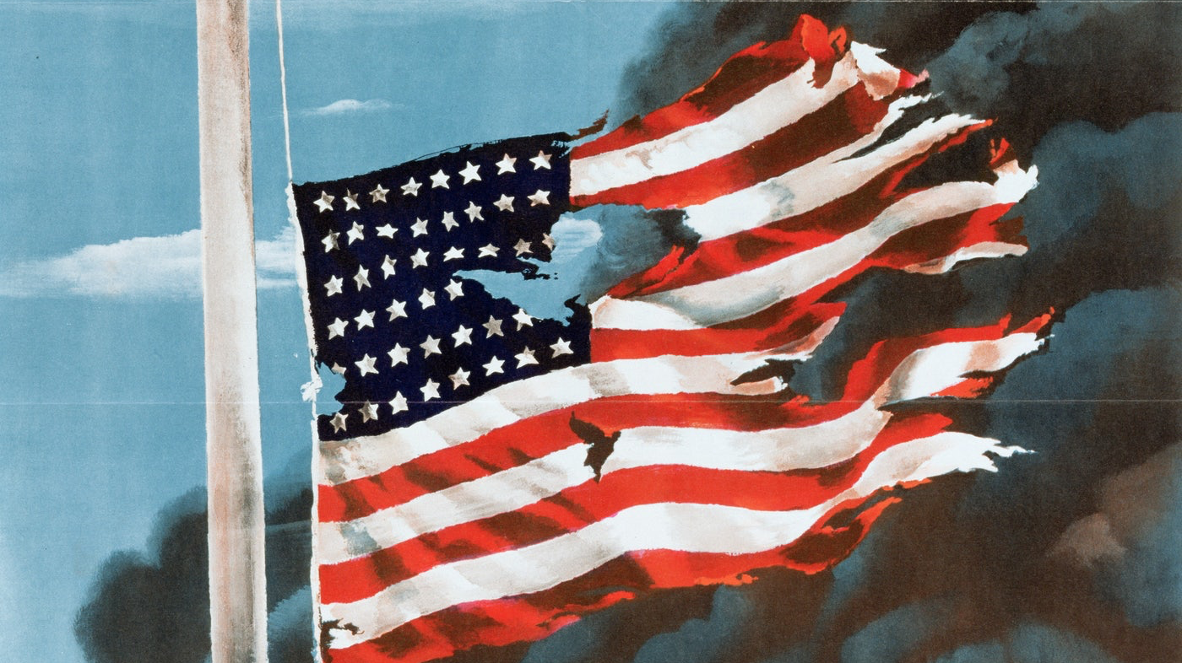
United States

Slide 2
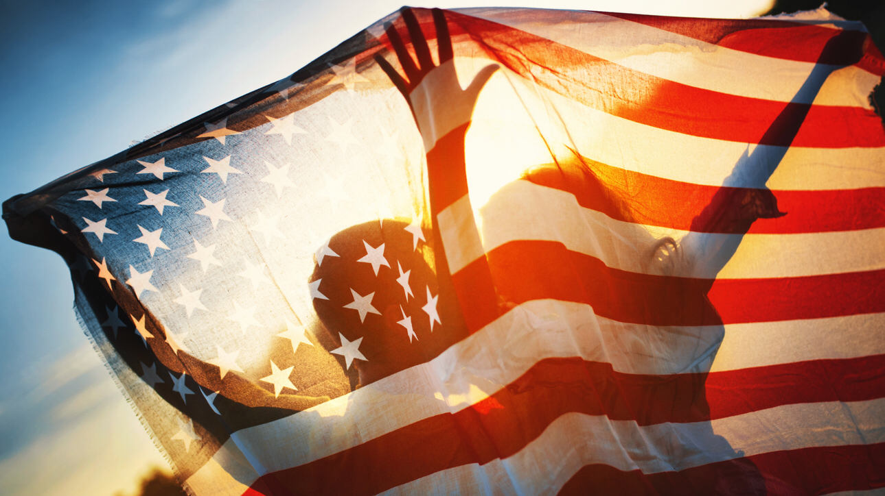
Location
Located in North America, the country is bordered on the west by the Pacific Ocean and to the east by the Atlantic Ocean. Along the northern border is Canada and the southern border is Mexico.

Slide 3
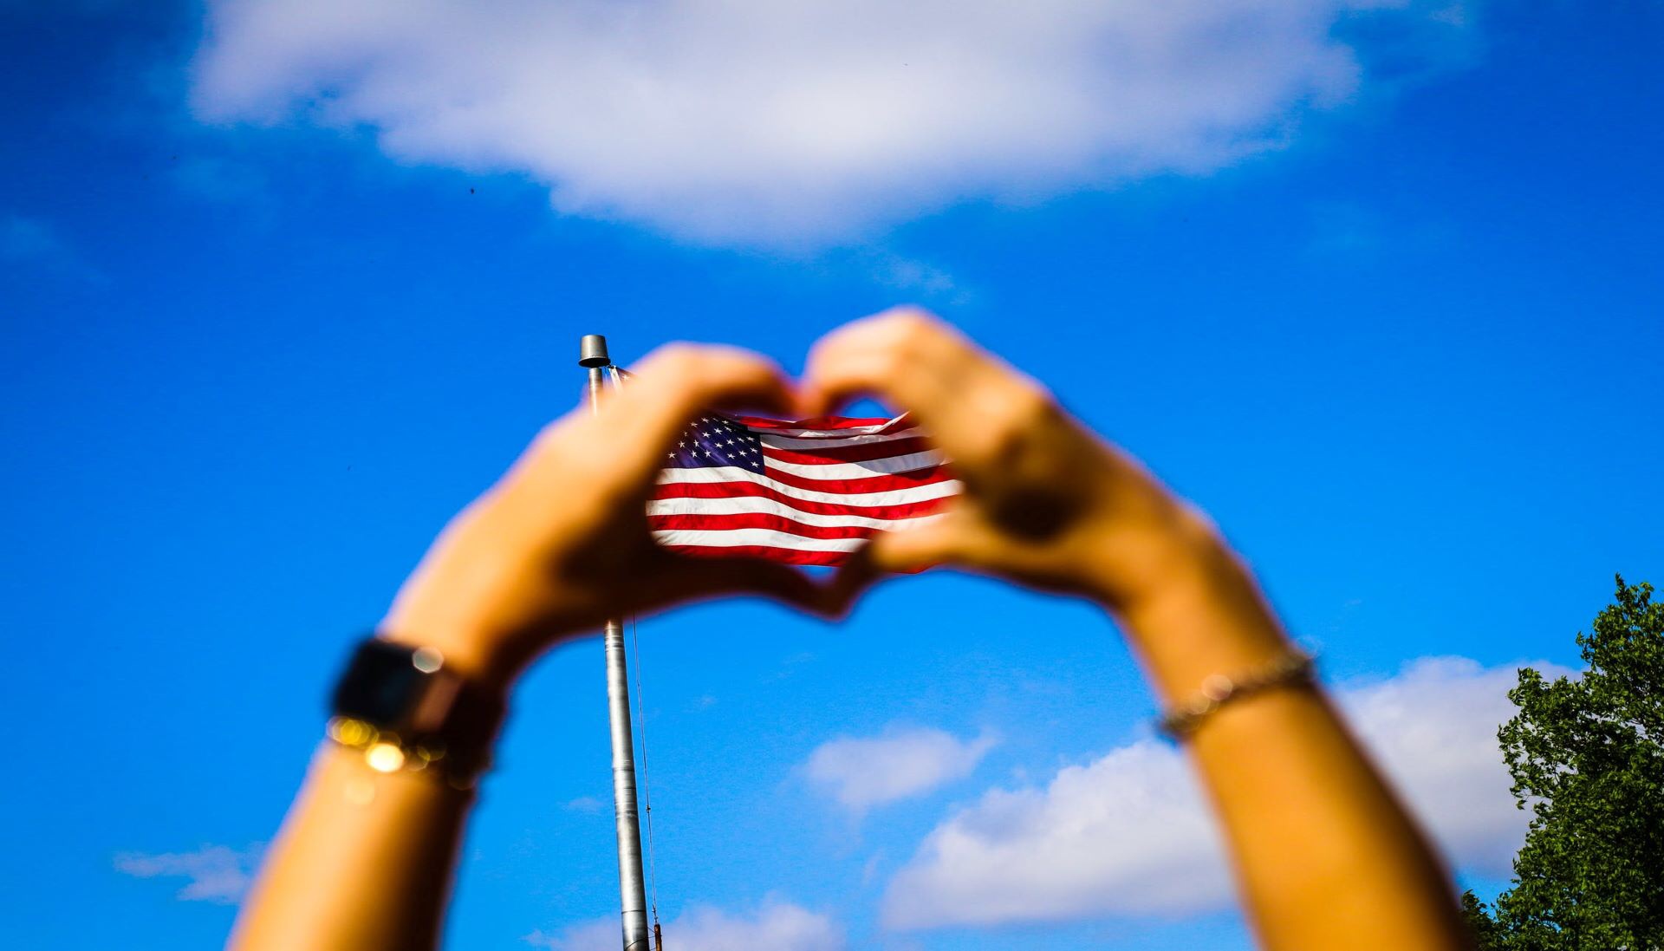
Population
In 2019 population in the USA is 328,3 million people. United States is 3 country in terms of population in the world.

Slide 4
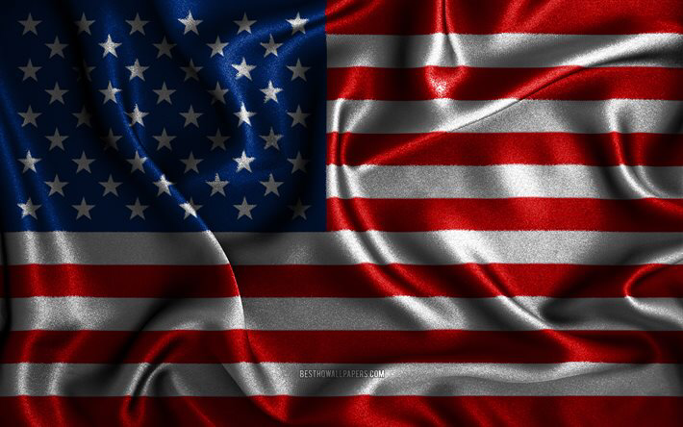
Language
The United States doesn’t has an official language at the federal level, however English is the de facto national language.

Slide 5
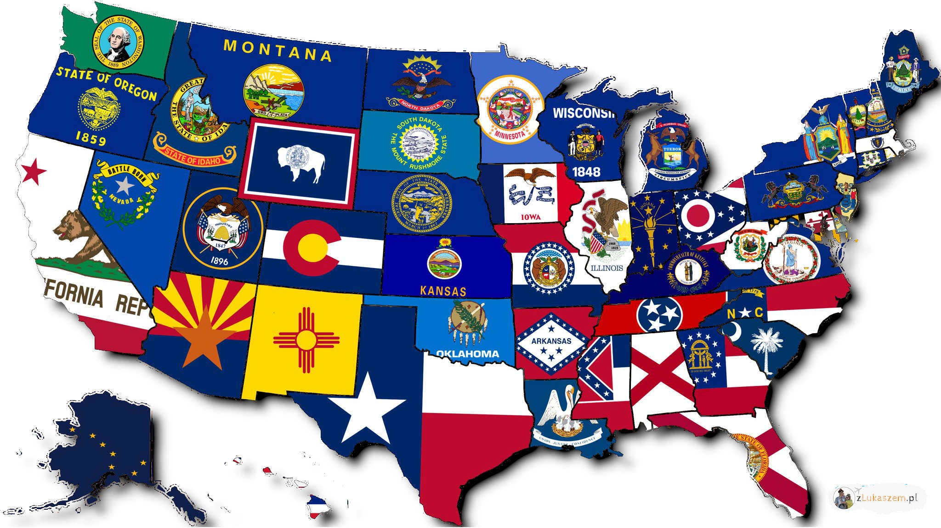
Administrative division
USA is divided into 50 states. In my opinion the most popular states in USA are Arizona, California, Florida, Hawaii.

Slide 6
Curiosites about USA
United States is 30 times larger than Poland.
The grizzly bear is an official animal of the state of California.
The first capital of the USA was New York.
Jazz, country, gospel, rock, blues, pop, disco, metal, grunge, hip-hop, house and techno were born in the United States.

Slide 7
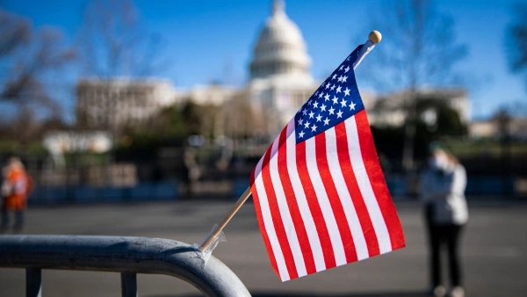
Curiosites about USA
The United States doesn’t has an official state religion.
It’s the first country to introduce public schools.
The most populous city in the United States is New York.
The Hawaiian language consists of only 12 letters.

Slide 8
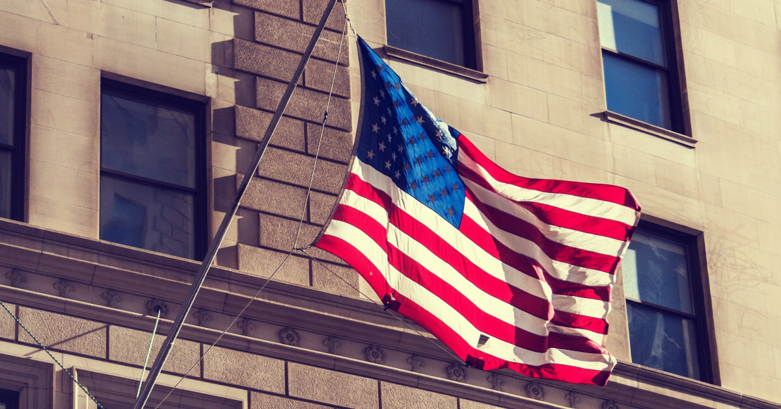
Monuments
Alcatraz- the most famous prison in the world- San Francisco,
White House- official residence and workplace of presidents in United States- Washington,

Slide 9
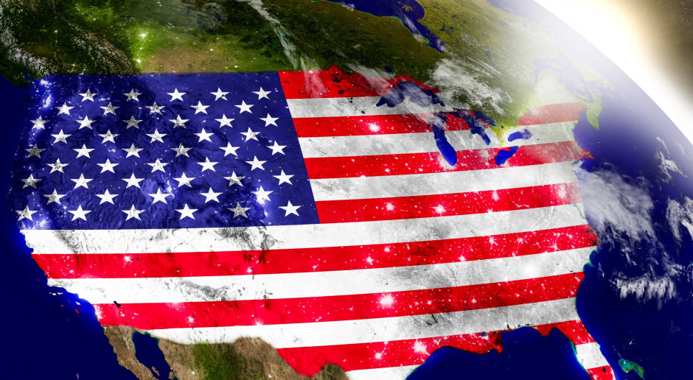
Monuments
George Washington Bridge- bridge, which connect New York with New Jersey- New York, New Jersey,
Mountain Rushmore- rock with 18 meters high faces of four USA presidents- South Dakota,
Statue of Liberty- statue, memorial, symbol of New York- Liberty Island, New York

Slide 10
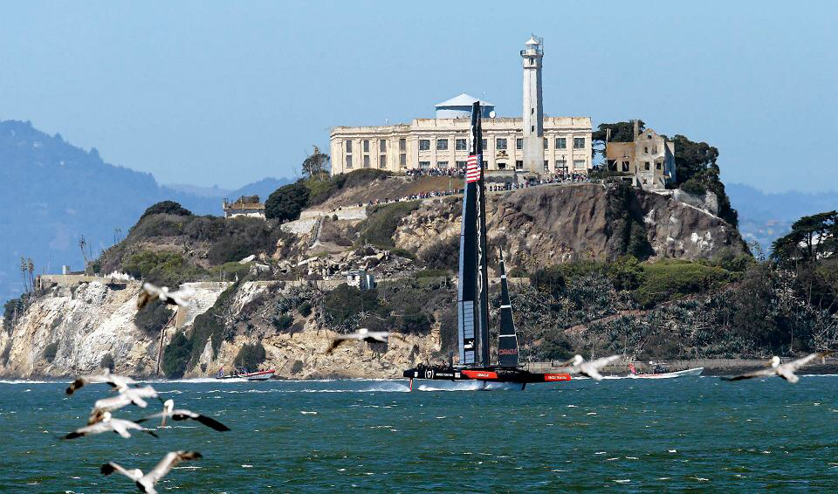
Curiosities about Alcatraz
Located on an island 2 km from San Francisco Bay, the prison was the place of imprisonment for 1,576 of America’s most ruthless criminals,
Today, Alcatraz Island is a great place to watch birds. There are many types of birds on the island, including falcons, ravens, hawks, cormorants, herons, gulls, guillemots, oystercatchers, night herons and snow herons.

Slide 11
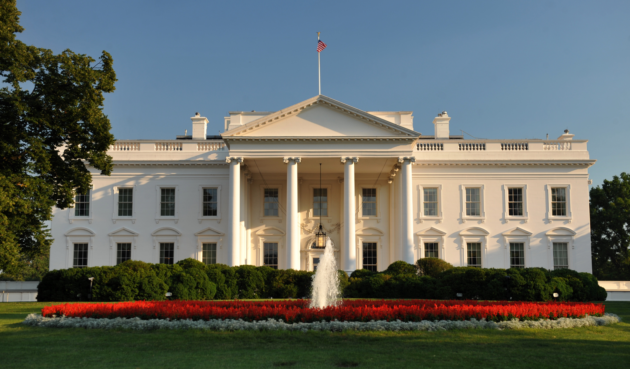
Curiosities about White House
In the White House are 132 rooms, 32 bathrooms, 412 doors, 147 windows, 28 fireplaces, seven stair exits, 3 elevators, a cinema, a bowling alley and a billiard room. There is also a tennis court and jogging track on the property.
The White House is the only presidential residence that is open to the public for free.

Slide 12
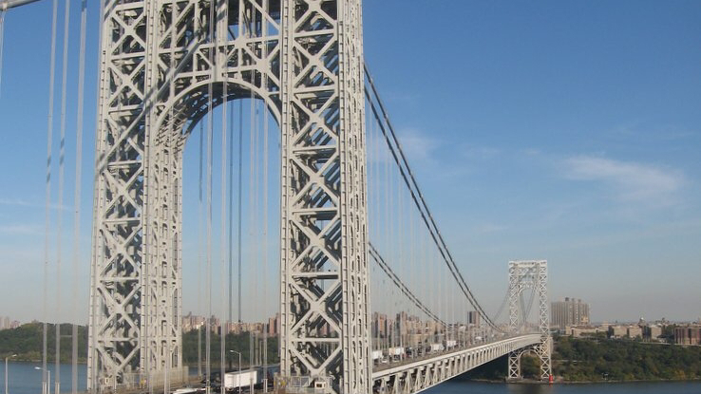
Curiosities about George Washington Bridge
Construction began in 1925 and took 6 years.
The official design of the bridge was created on the drawing board of the Swiss engineer Othmar H. Amann, but Cass Gilbert became an architect, and Amanna became chief engineer.

Slide 13
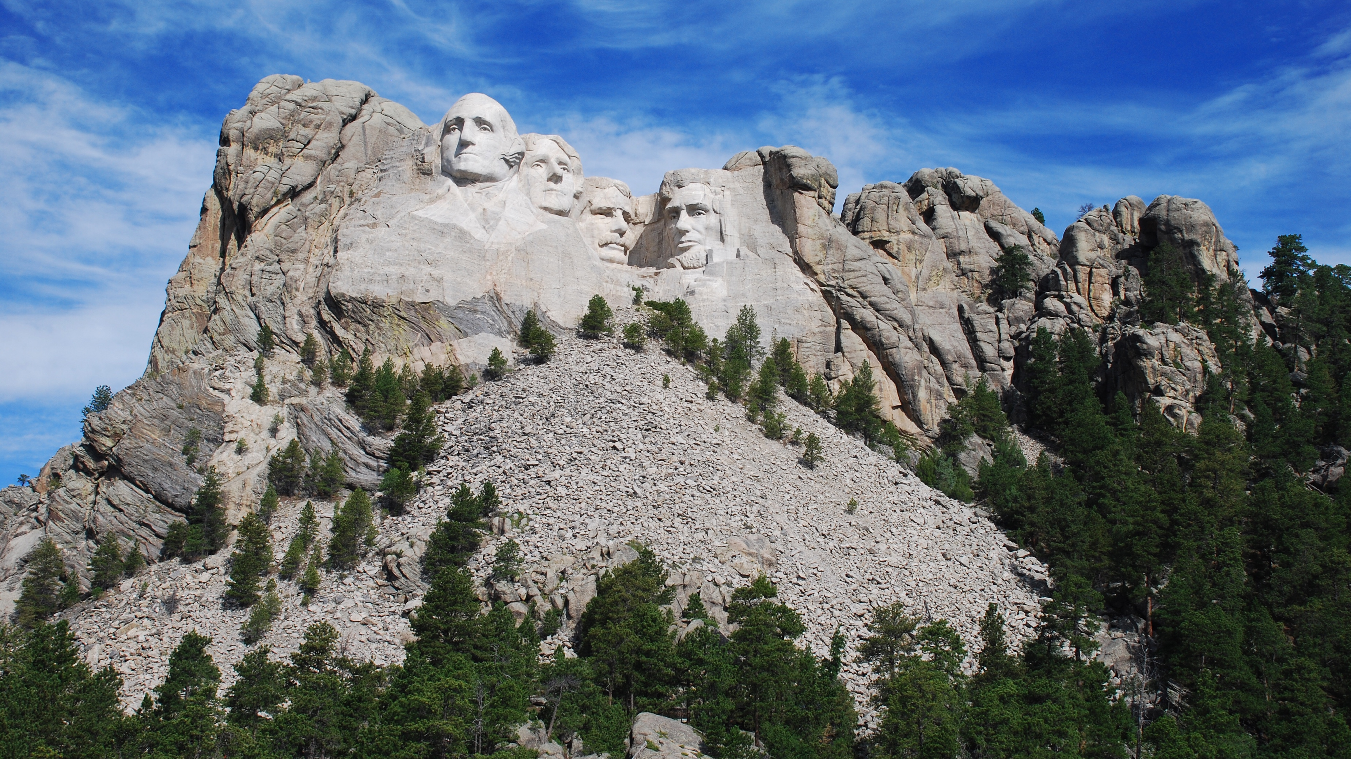
Curiosities about Mountain Rushmore
The 18 meter high faces of four American presidents: George Washington, Thomas Jefferson, Theodore Roosevelt and Abraham Lincoln peer from the vertical granite rock.
The entire relief is visible from a distance of 100 km.

Slide 14
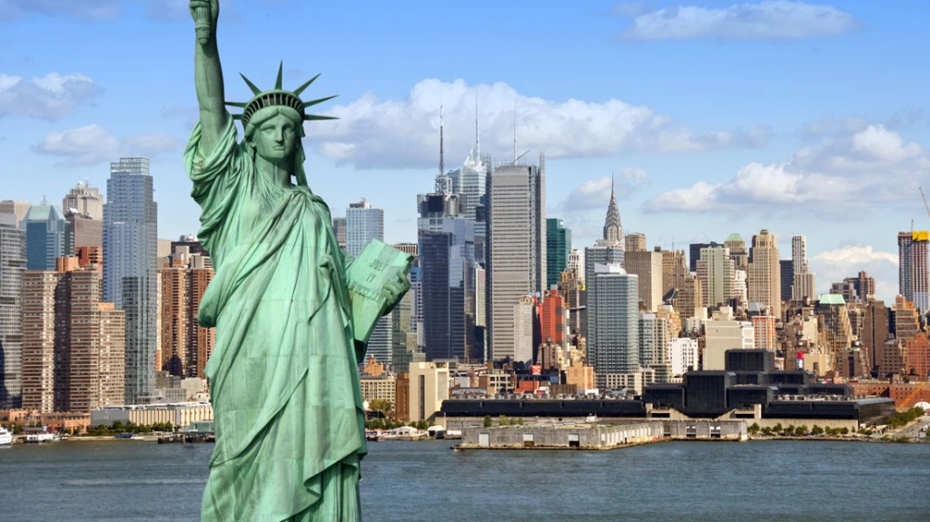
Curiosities about Statue of Liberty
The Statue of Liberty was originally called "Freedom to Enlighten the World".
The design of the steel structure was made by Gustaw Eiffel in France, then the dismantled parts were transported to the USA by sea.

Slide 15
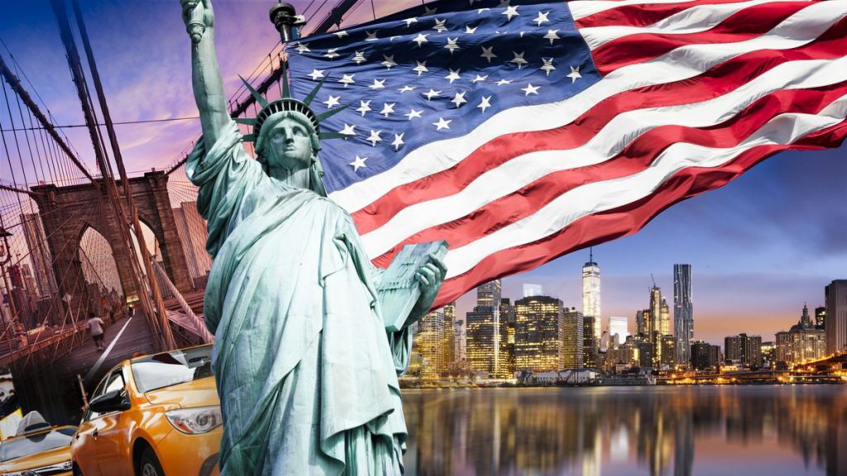
Sources
https://pl.m.wikipedia.org/wiki/Wikipedia:Strona_główna,
https://www.budowle.pl/budowle/panstwo/stany-zjednoczone,
https://poznajnieznane.pl/ciekawostki-2/ciekawostki-panstwa-3/stany-zjednoczone-ciekawostki/.

Slide 16
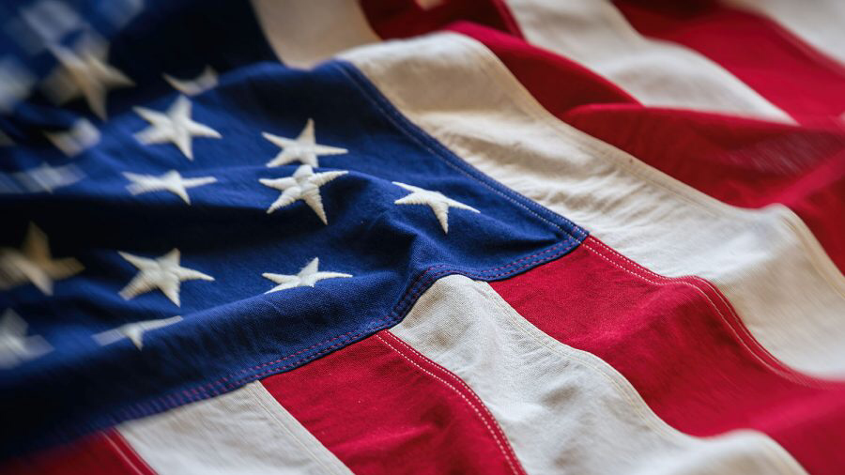
The End
Thanks for attention!
Author: Agata Kaźmierczak 1TF

