Slide 1
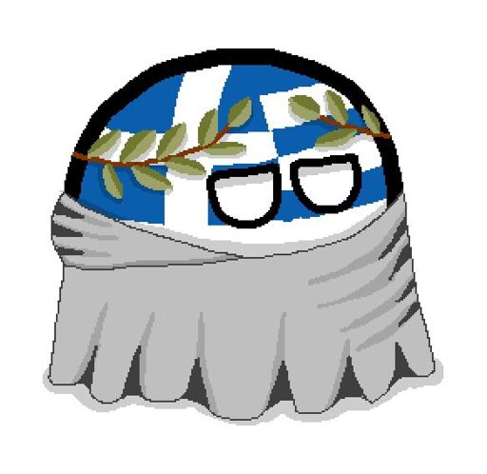

Slide 2
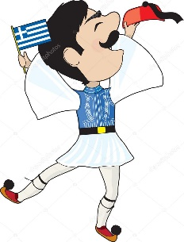
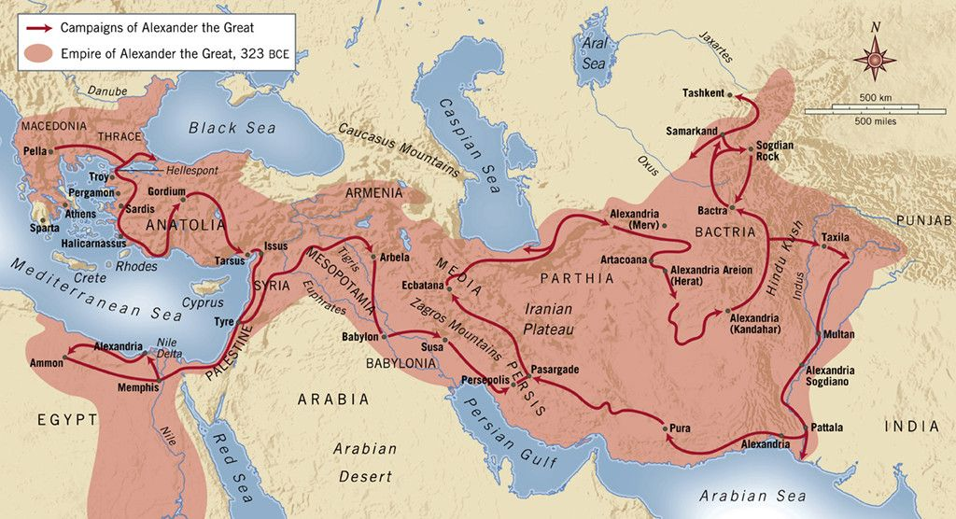
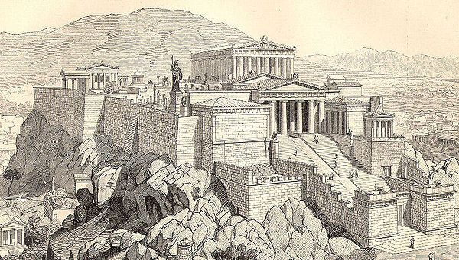
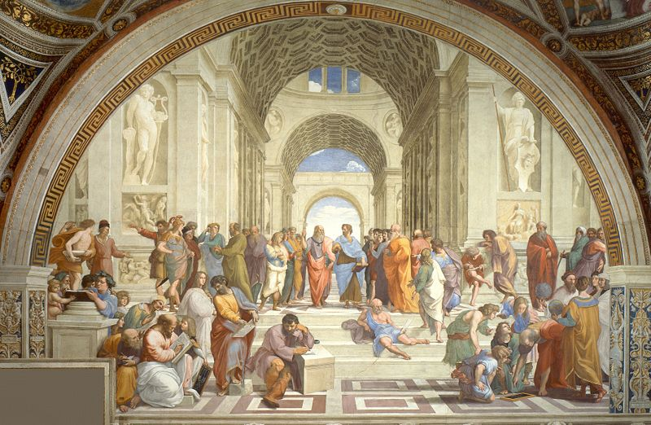
Heritage - history
The Greeks are one of the oldest nations in the world. They have survived for thousands of years, to the present day and in many times they had a big influence on the development of culture and history of their homeland, Europe, Asia and the whole world. They are the successors of ancient Hellas, the birthplace of democracy, philosophy, the Olympic Games, mathematics, literature, historiography, theater and medicine. Some of the greatest powers in history, such as the Byzantine and the Macedonian Empire, are also the work of the Greeks. Together with Italy, they also successors the achievements of the Roman Empire. There are 18 UNESCO Cultural Heritage Sites in the Hellenic Republic.

Slide 3
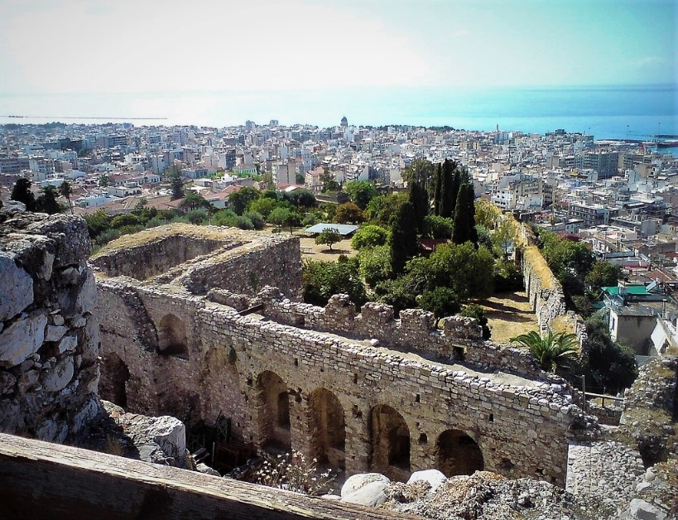
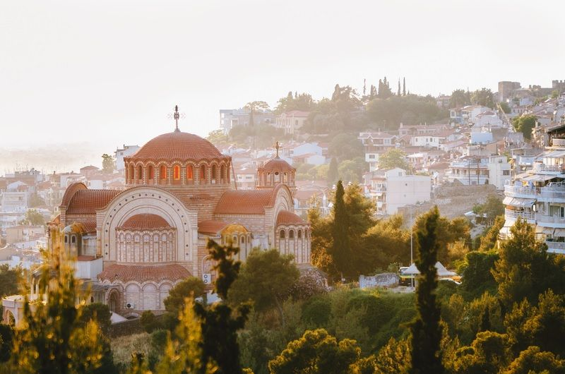
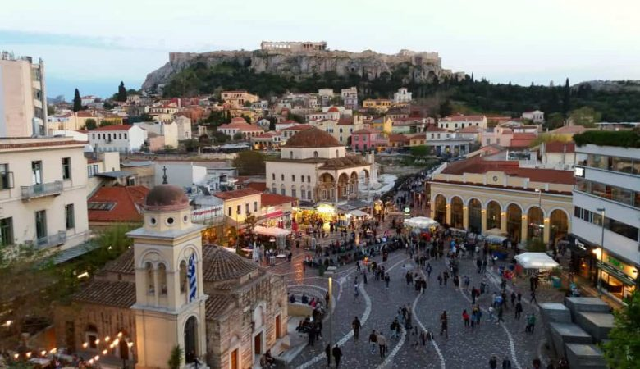
Geography - cities
The capital of the Hellenic Republic is Athens. It is the largest city in the country, has about 700 000 citizens and is one of the most visited tourist place in Europe. The second largest is Thessaloniki, the capital of the largest region in Greece - Macedonia. Another important city is Patras, situated on the Peloponnese peninsula and is one of the most important Greek seaports.
Patras (gr. Patra)
Athens (gr. Atina)
Thessaloniki (gr. Tesaloniki)

Slide 4
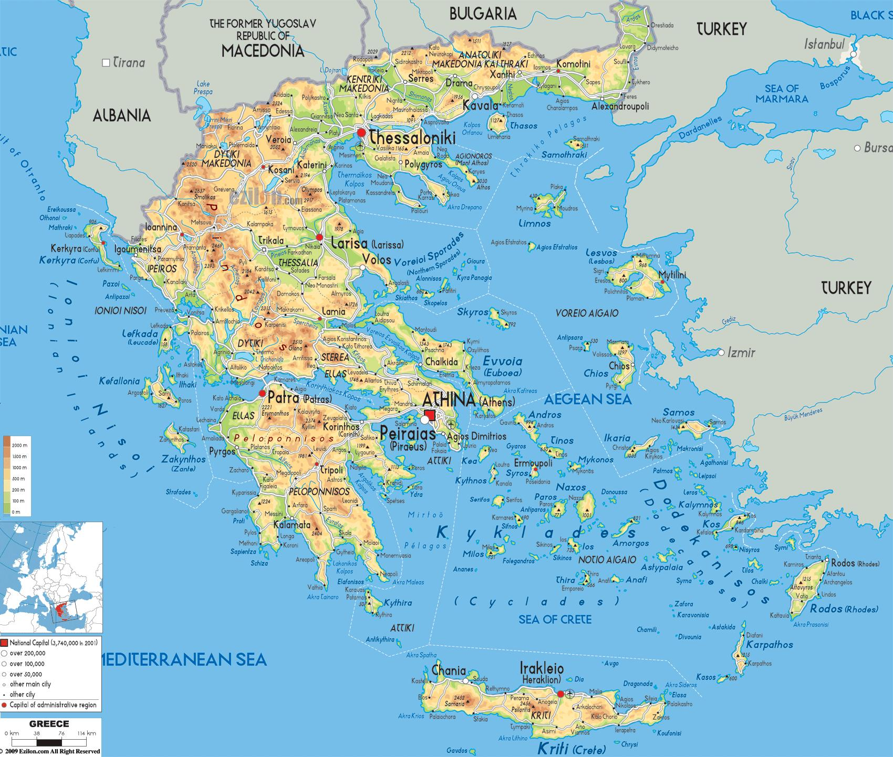
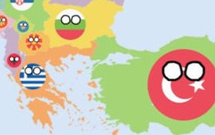
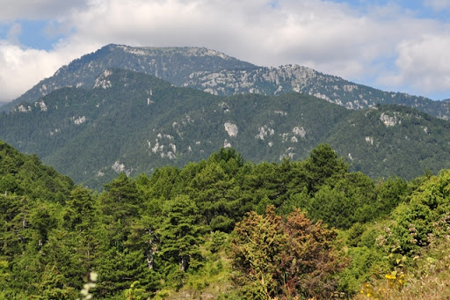
Geography - continent
Greece is located in the south of the Balkans and covers an area of 131,990 km². In total, it has 4 neighbors in the north and east, these are Albania, North Macedonia, Bulgaria and Turkey. The most majority of the Greek mainland is covered by mountains with an average altitude of 1,200 - 1,900 m above sea level. The highest point is Mount Olympus, the mythological location of the ancient gods, reaching 2,917 meters above sea level.

Slide 5
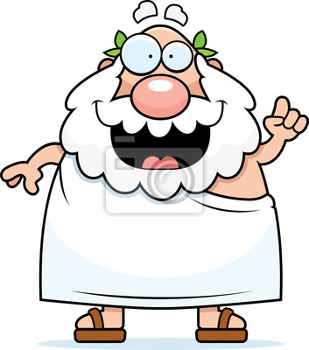
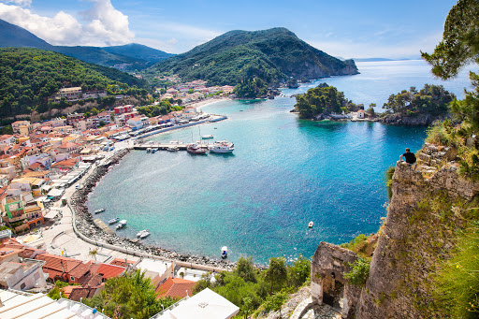
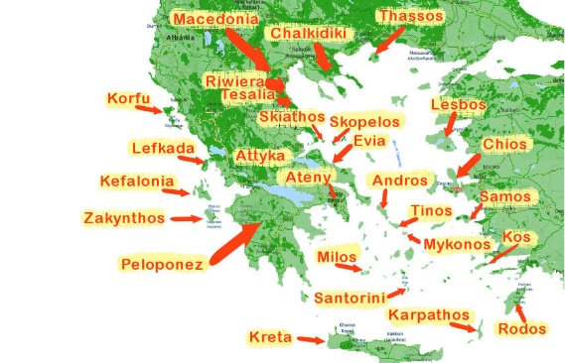
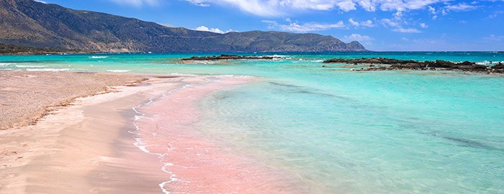
Geography – islands and coast
Homer's homeland has the third longest coastline in Europe and the first on the Mediterranean Sea, 13,676 km long. There are also almost 3,000 islands within its borders, the largest of which is Crete. Both the continent's coast and the islands are famous in the whole world for their clean waters and attractive beaches. There are also many bays and peninsulas in Greece.

Slide 6
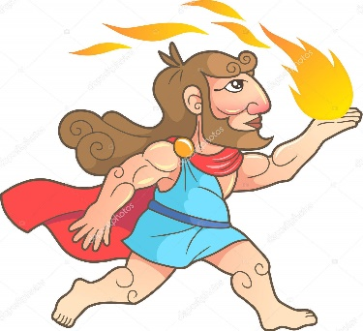
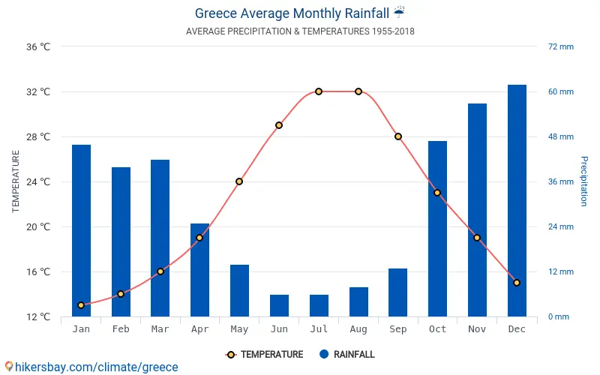
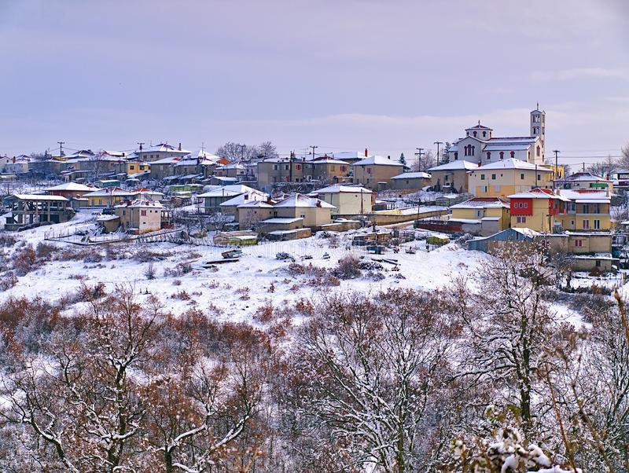
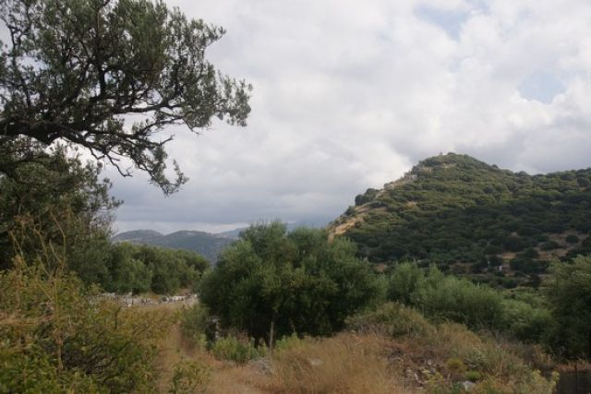
Climate
As in many other countries bordering the Mediterranean Sea, Greece is dominated by a Mediterranean subtropical climate. Therefore, long, hot and dry summers and wet winters are no strangers to Greeks. However, such weather is most common in the south and in the central part of the country. In the north, the climate is cooler, so we find more plants there.

Slide 7
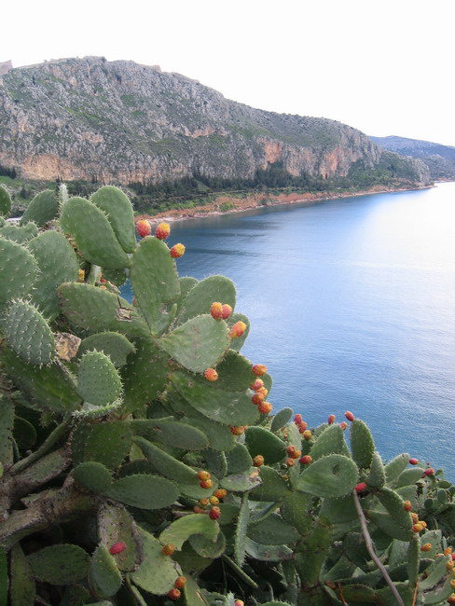
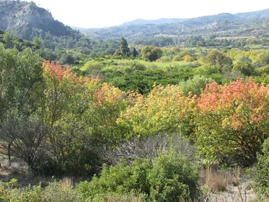
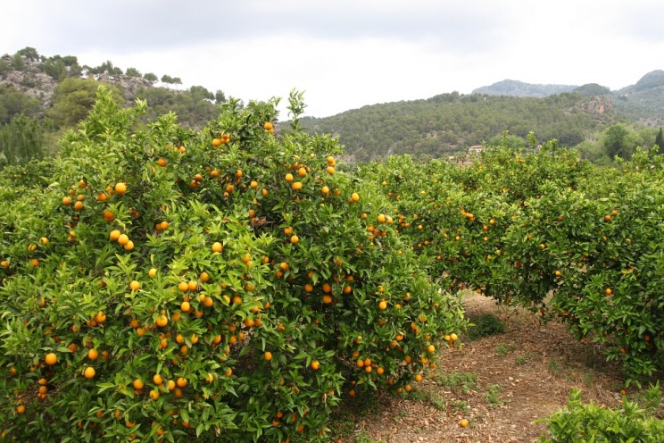
Flora
For centuries, in the homeland of democracy, grubbing up the forests has been carried out for the needs like urbanization and grazing of goats. Therefore, they currently occupy 20% of the country's territory. We find oaks, pines and cypresses there. In places where forests used to be, there is a typical Mediterranean macchia, large clusters of shrubs. Olive groves, citrus, grapevines, and even cacti and agaves imported from America are also popular.

Slide 8
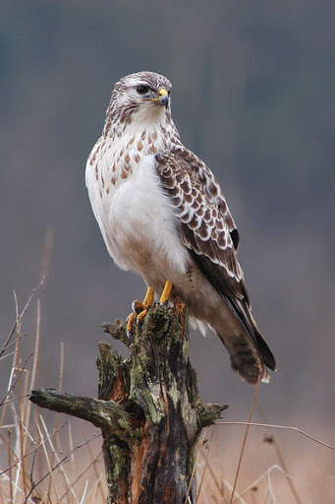
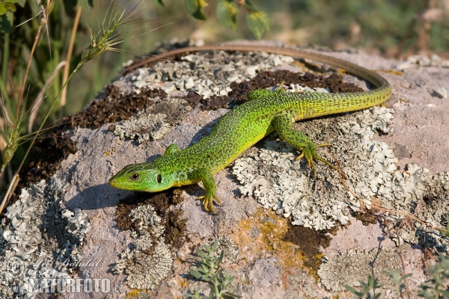
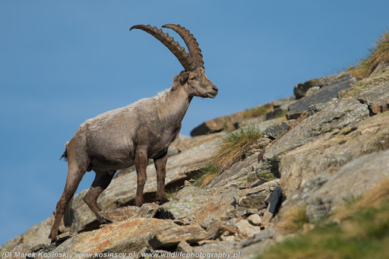
Fauna
Because Greece is not a lowland country, most of the animals live in the mountains. There you can meet birds such as vultures, falcons, buzzards and eagles. Wolves, brown bears, lynxes and ibexes also live in the highlands. The forests are home for foxes, badgers, squirrels, hares and hedgehogs. In Greece, we find many types of lizards, snakes and turtles. The most common insects are common butterflies, beetles and grasshoppers.

Slide 9
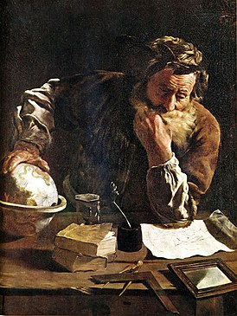
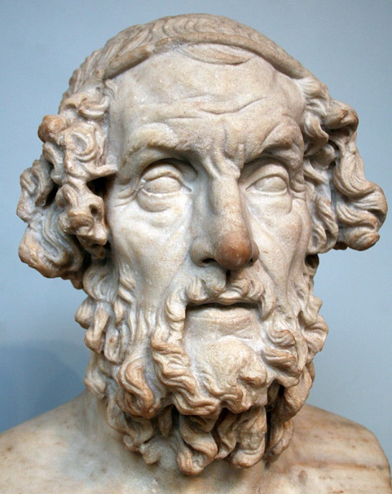
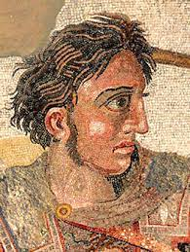
Famous personalities –
antiquity
Archimedes
The sixteen-million Greek nation has a long history and brought many outstanding people to the whole world. Already in ancient times, the creators of timeless art were such poets as Homer, Sappho and Sophocles. Philosophers such as Aristotle, Socrates, and Plato have wondered over great questions. The geniuses of strategy and politics were Alexander the Great, Pericles, and Klearchos of Sparta. The achievements of the doctor Hippocrates and the mathematician Archimedes are also valued today.
Homer
Alexander the Great

Slide 10
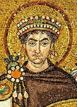
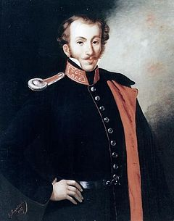
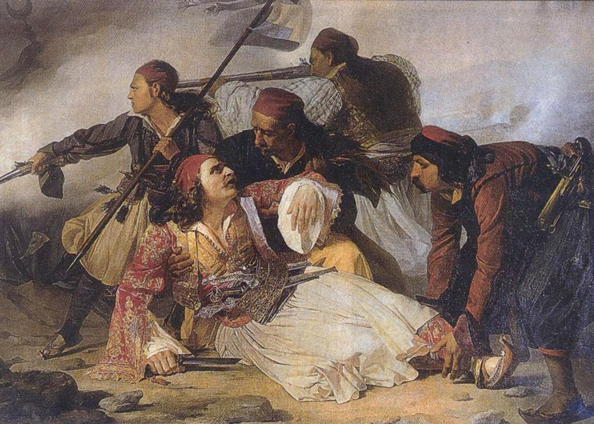
Famous personalities –
medieval and early modern period
Justinian I the Great
In the Middle Ages, the heritage of the Roman Empire was defended by emperors of Greek origin, such as Justinian I the Great, Heraclius and Leo III the Isaurian. In 1821, when the sons of the ancient Hellenes fought with the Ottoman Empire for independence, such commanders as Markos Botsaris, Dimitrios Ipsilantis and Notis Botsaris stood out with heroism.
Dimitrios Ipsilantis
The death of Markos Botsaris, painting by Ludovico Lipparini

Slide 11
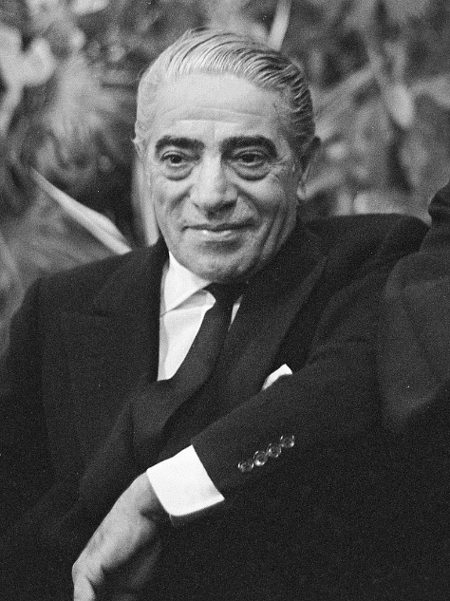
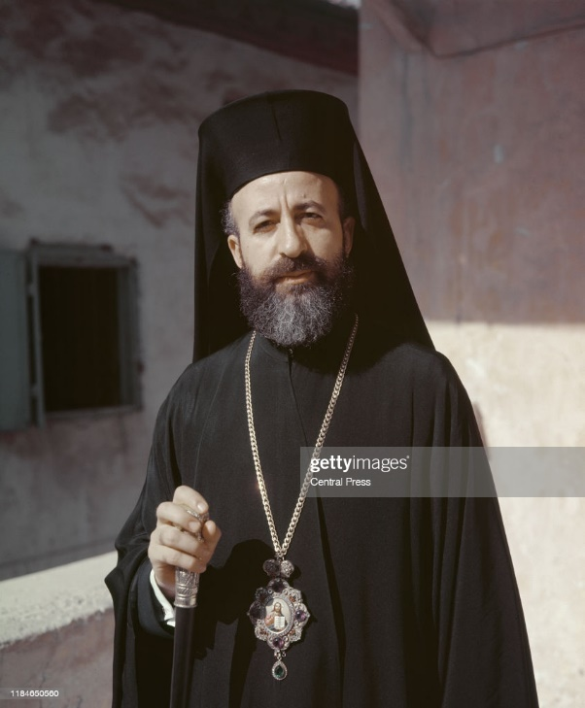
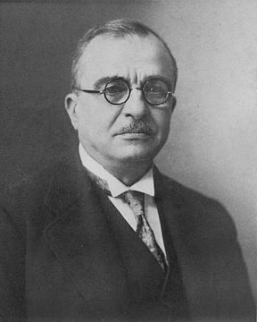
Famous personalities –
modern period
Aristotelis Onasis
Even today, the Greek people are represented by talented people. These are for example the eight-time prime minister Eleftherios Venizelos, the politician Joanis Metaxas, the millionaire Aristotelis Onasis and the Archbishop of Cyprus, Makarios III.
Makarios III
Joanis Metaksas

Slide 12
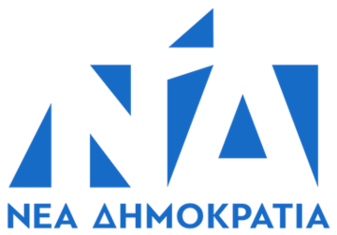
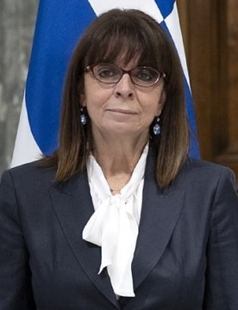
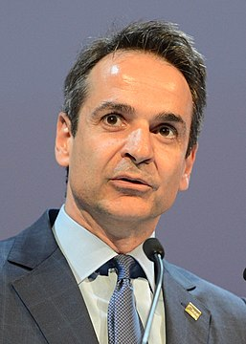
Political situation
Logo „New Democracy”
The Hellenic Republic is a parliamentary democracy. It is represented by a president elected by parliament for a five years. The president and parliament exercise legislative power. Three hundred deputies elected every four years are members of the parliament. Since 2019, the prime minister of Greece is Kiriakos Mitsotakis, coming from the conservative-liberal New Democracy party. On January 22 2020, Ekaterini Sakielaropulu became the president of Greece, she is the first woman holding this position in the history of the country.
Ekaterini Sakielaropulu
Kiriakos Mitsotakis

Slide 13
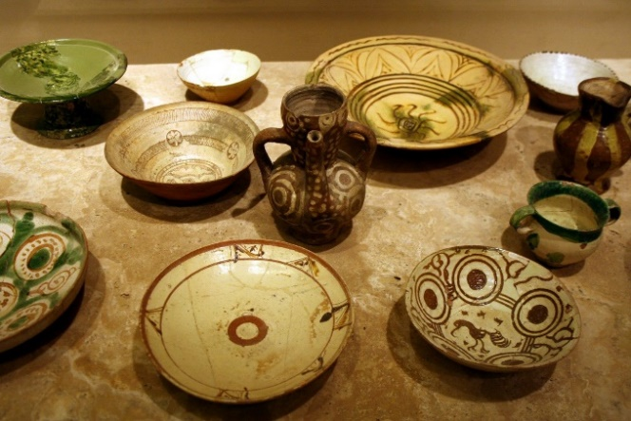
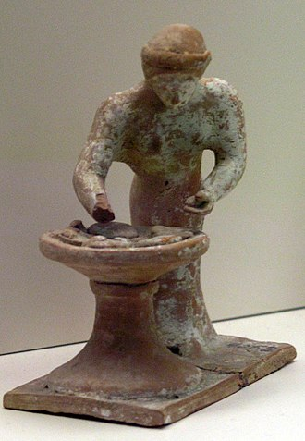
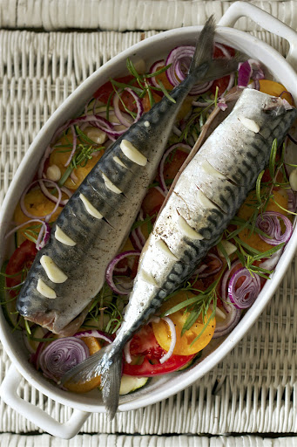
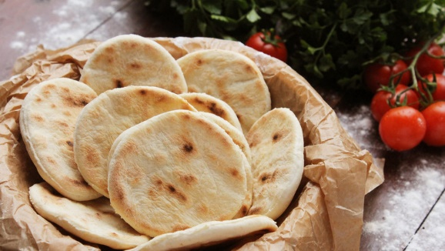
Cuisine – tradition
Greek woman preparing bread (terracotta figure from the beginning of the 5th century BC)
Greek cuisine has as much a centuries-old and rich heritage as the history of the nation itself. Archestratos wrote the first ever cookbook in 330 B.C.E. The ancient Hellenes used little ingredients, mainly wheat, oil and wine. Meat was eaten exceptionally, fish more often. This habit continued in Roman and Ottoman times. Thanks to trade routes, the citizens of the Byzantine Empire learned about new spices and inspirations from Arabia and Persia.

Slide 14
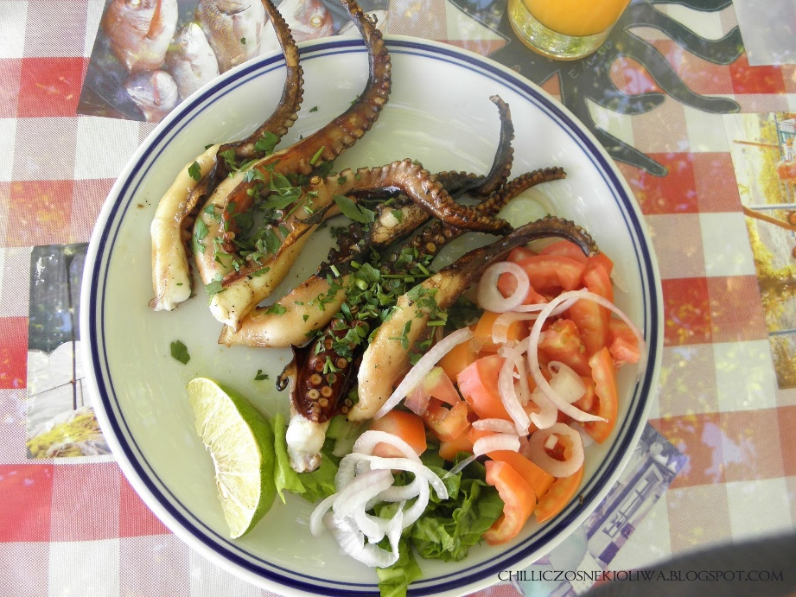
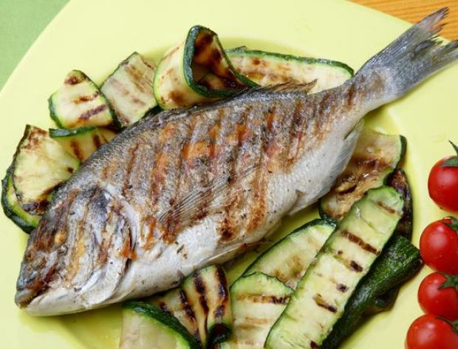
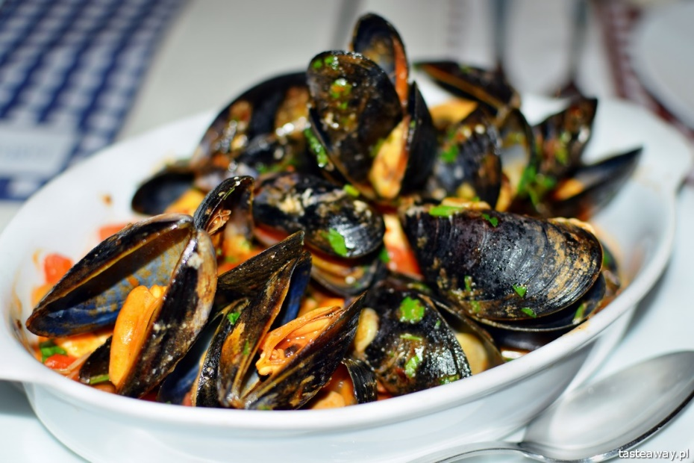
Cuisine – fishes
On Greek tables, we can find many types of fish and ways of preparing them. Tuna, shrimp, crab clams, cod, flounder, mackerel and trout are some of them. The Greeks serve them grilled, seasoned with garlic and lemon juice, baked with yoghurt and herbs, or cooked in a thick tomato sauce.

Slide 15
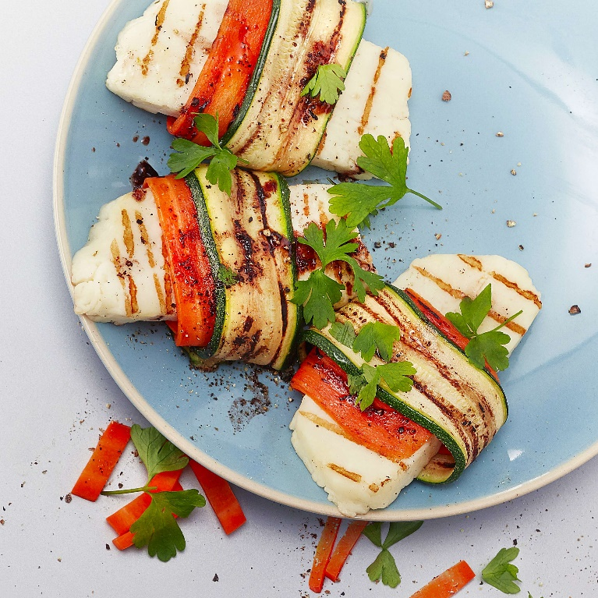
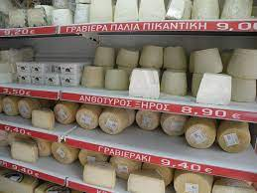
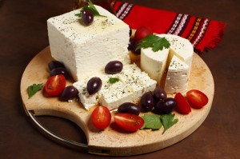
Cuisine – dairy
In the south of the Balkans, the most popular cheese is feta, of Greek origin. Made from a mixture of sheep's and goat's milk or from sheep's milk only. As a brittle cheese that melts well at high temperatures, it is a very popular ingredient and an important symbol of Greek cuisine. In addition to feta, there are many other regional varieties of cheese such as: hard yellow kefalotiri, mild engraving and unripe Cypriot chalumi.

Slide 16
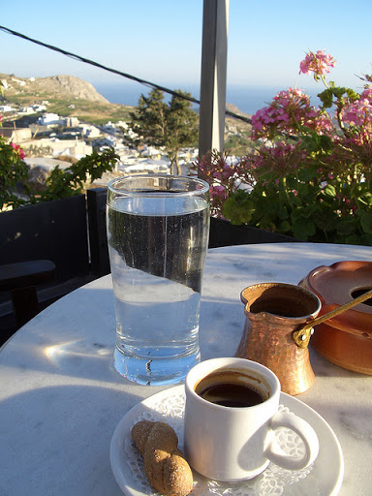
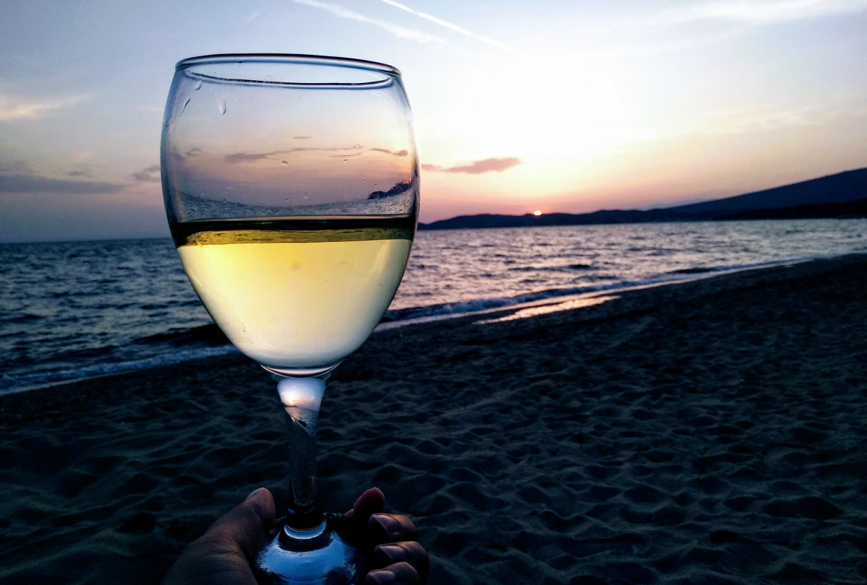
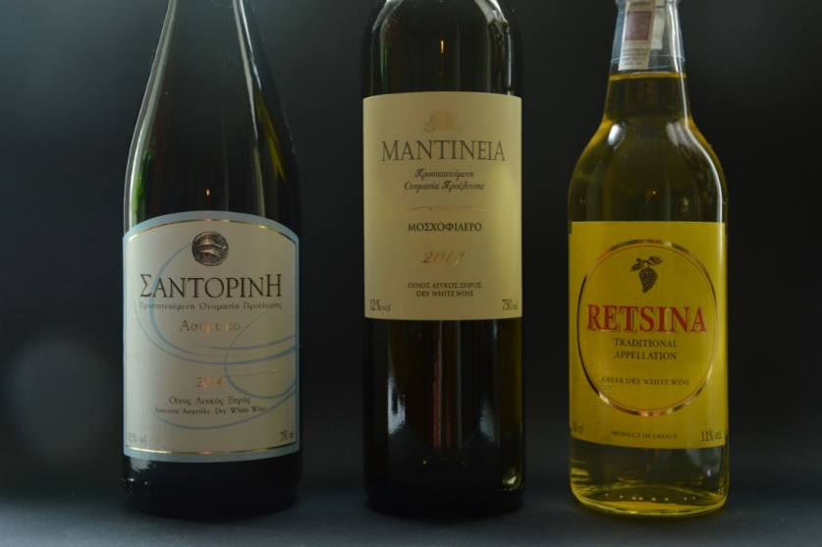
Cuisine – drinks
The most popular drink among the Greeks is coffee. Always served as kafedáki in small cups. It is usually refilled with a glass of ice water and a cookie. A frequent addition to coffee is a glass of fresh water, nero fresco, traditionally served to each guest. Greece also offers many types of wines, spirits and liqueurs.

Slide 17
Army
Greek troops on the Anatolian Expedition (1919-1921)
In 2014, the Greek land forces, (Ellenikόs Stratόs) had 1244 tanks and 3571 armored fighting vehicles. The army numbered approximately 178 thousand professional soldiers and 280 thousand reservists. Annual defense budget of $ 6.5 billion. According to the Global Firepower Military Potential Ranking, the Greek land forces were ranked 57th in the world.
Ancient Hoplites fighting in a tight formation – the phalanx

Slide 18
King of Persia Xerxes I observes the defeat of his fleet at Salamis (480 BC)
Fleet
In the Greek seas, small and agile ships almost always had the advantage. The ancient, Athenian sailors knew this well, which is why defeated larger and more numerous Persian units at the Battle of Salamis. The use of this tactic in the naval battle of Samos in 1824 also brought the Greeks victory over the Turks and helped them regain independence. The modern navy of this country (Polemiko Naftiko) has 35 coastal defense ships, 13 frigates and 8 submarines.

Slide 19
Air force
In 2014, the Greek Air Force (Polemikí Aeroporía) had 224 fighters, 205 transport aircrafts, 156 training and combat aircrafts and 231 attack helicopters.

Slide 20
Source materials
www.wikipedia.com
www.globalfirepower.com
www.dianekochilas.com

Slide 21
Thank You for Your attention
Jakub Adamów II TID

